Slide 1
Git
Version control and Collaboration

Slide 2
Content
What is version control
Git software
Git workflow
Tips

Slide 3
What is version control
Keep previous backups (v1.0, 1.2, 2.0)
Keep different versions of project (New UI, etc.)
Collaboration
  I work on one version you work on another

Slide 4
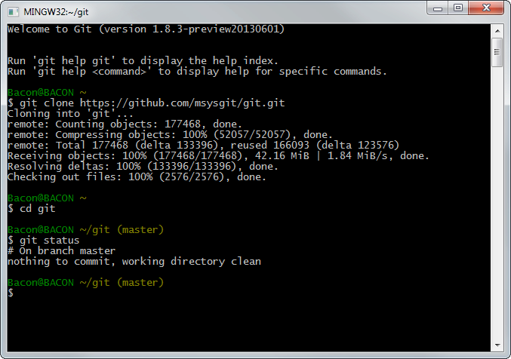
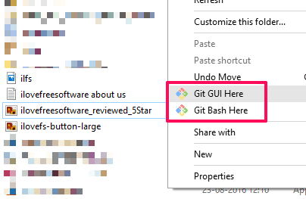
The git software
Git for windows
Terminal
Right click
$git status

Slide 5


Git clone
Clones a repository into a newly created directory.
Github
$git clone projectx@github.git
Your PC

Slide 6
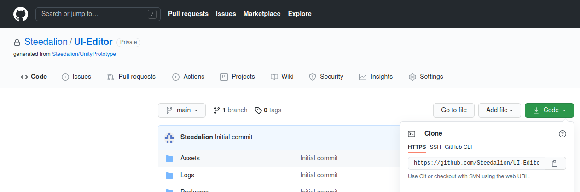
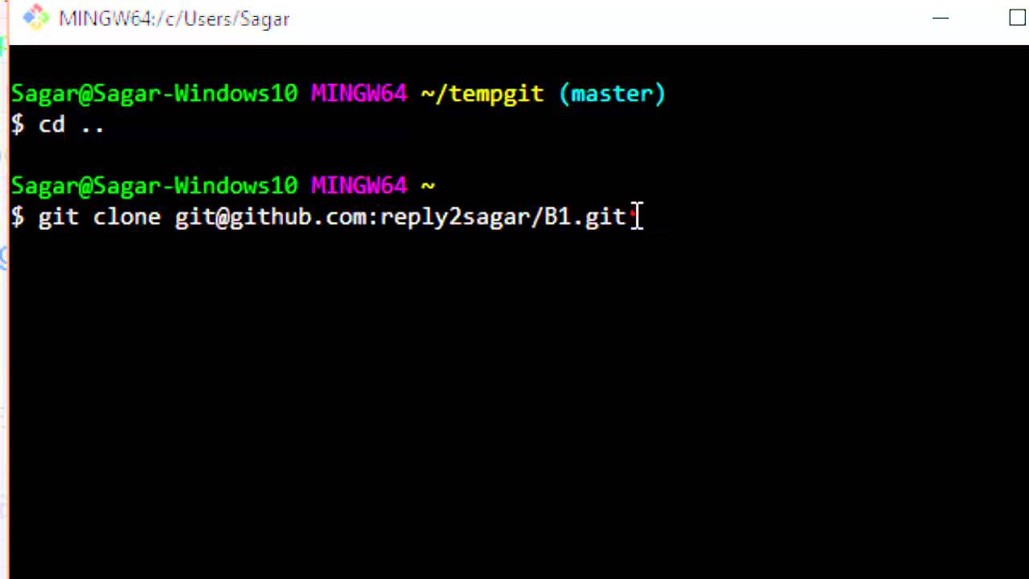
Github Git clone

Slide 7
Git branch
Currently on master branch
Master Branch

Slide 8
Creating a branch
$git branch SparklyUI
Creates a separate branch on your computer.
Your PC
Master Branch
SparklyUI

Slide 9
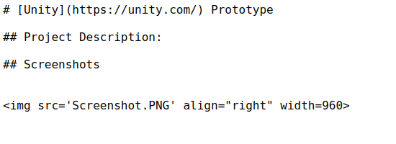
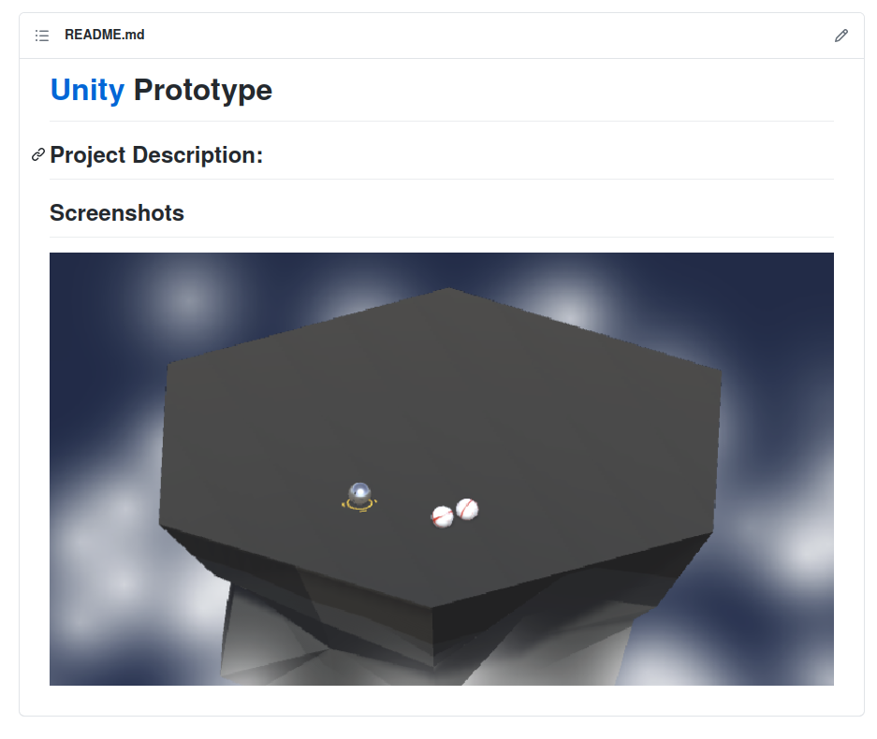
Edit project
Change the picture

Slide 10
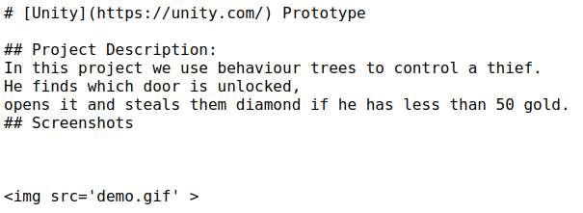
Change the image and Readme file
Added image
Modify Readme.

Slide 11
Committing changes
We commit the changes to the current branch.
  Add files to the commit
  Commit the changes to the branch
$git add .
$git commit

Slide 12
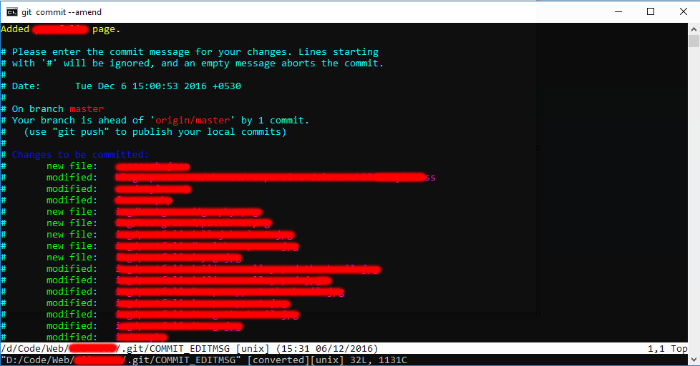
Git commit message
Commit message e.g:
Updated the Readme figure
Each commit needs a message
Files changed

Slide 13
Commits = tasks
Add some more changes (...)
Your PC
Master Branch
SparklyUI
Readme Update
...

Slide 14
Merging
$git checkout main
$git merge SparklyUI
Combine the changes with the main branch
Your PC
Master Branch
Sparkly
SparklyUI
Readme Update

Slide 15
Now to update the online repo
$git push origin
Combine with online repo
Your PC
Master Branch
Sparkly

Slide 16
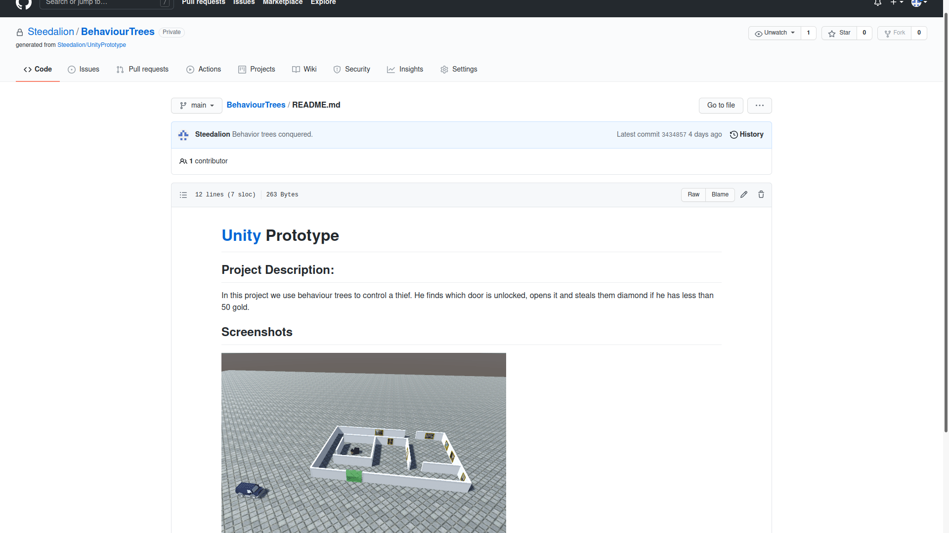
See online repo (Github)
Picture has changed

Slide 17
Collaboration
Same starting point
Work concurrently
Merge results
Version 2
-Fixed Light
-Sparkly
Starting Point
Sparkly
Peter Updates UI
Master Branch
Mary Fixes light
Sparkly
Master Branch
Fixed light
...
...

Slide 18
Thank you

